Slide 1
Start
Language Settings
Home
New Screen Transition to
Events
Tickets
New Screen Transition
Members
Ticket options
Registration/Login
Event information
Ticket Quantity
Event sign up screen
Added To Basket
Review Member Settings
Checkout
End

Slide 2
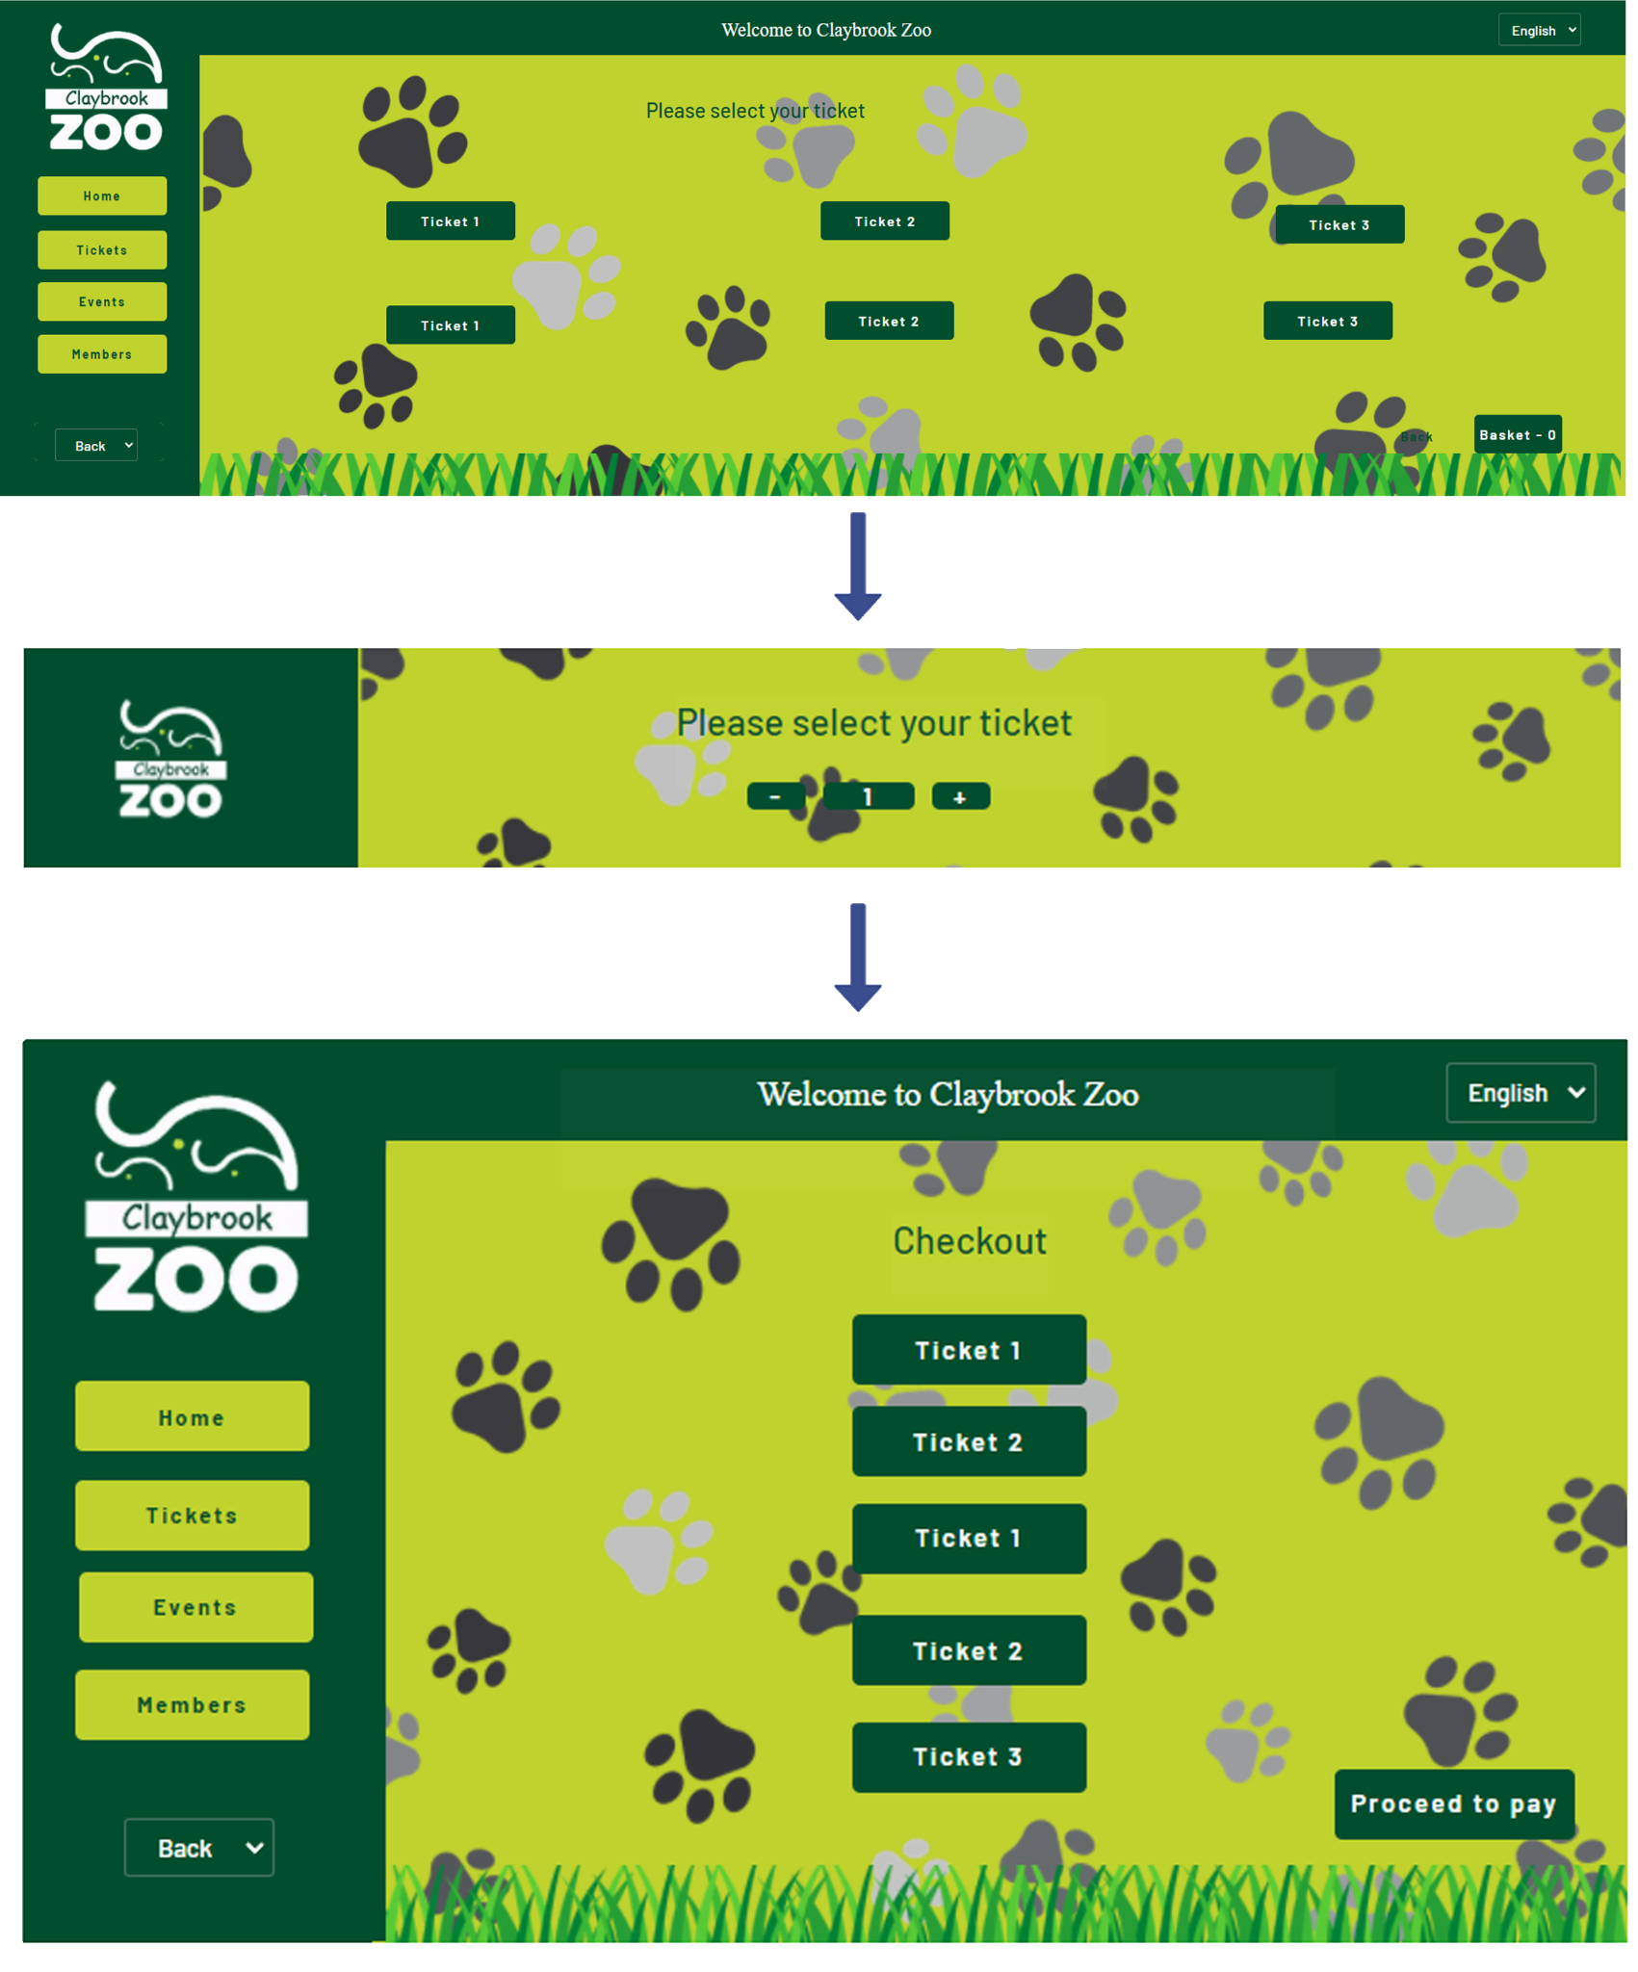
Language Settings
New Screen Transition to
Events
New Screen Transition to
Events

